Slide 1


CreatorsYard
Supervised by
Dr. Nada Ghneim
Eng. Waed Khwies

Slide 2
Outlines
Scope
Analysis Phase
AI Section
Technologies
Now & Next

Slide 3
Scope
Comprehensive platform that combines Content Performance Analytics and Video & Graphic Editing capabilities to enhance content creation and engagement across various social media platforms

Slide 4


Why CreatorsYard

Slide 5
Similar Applications
 | Hootsuite | Canva | CreatorsYard
Ease of Use | Medium | High | High
Scalability | High | High | Meduim
Interactive System | Powerful | Provided | Provided
AI Features | Not Provided | Not Provided | Provided

Slide 6
Outlines
Scope
Analysis Phase
AI Section
Technologies
Now & Next

Slide 7
Analysis Phase
Use Case
Block

Slide 8
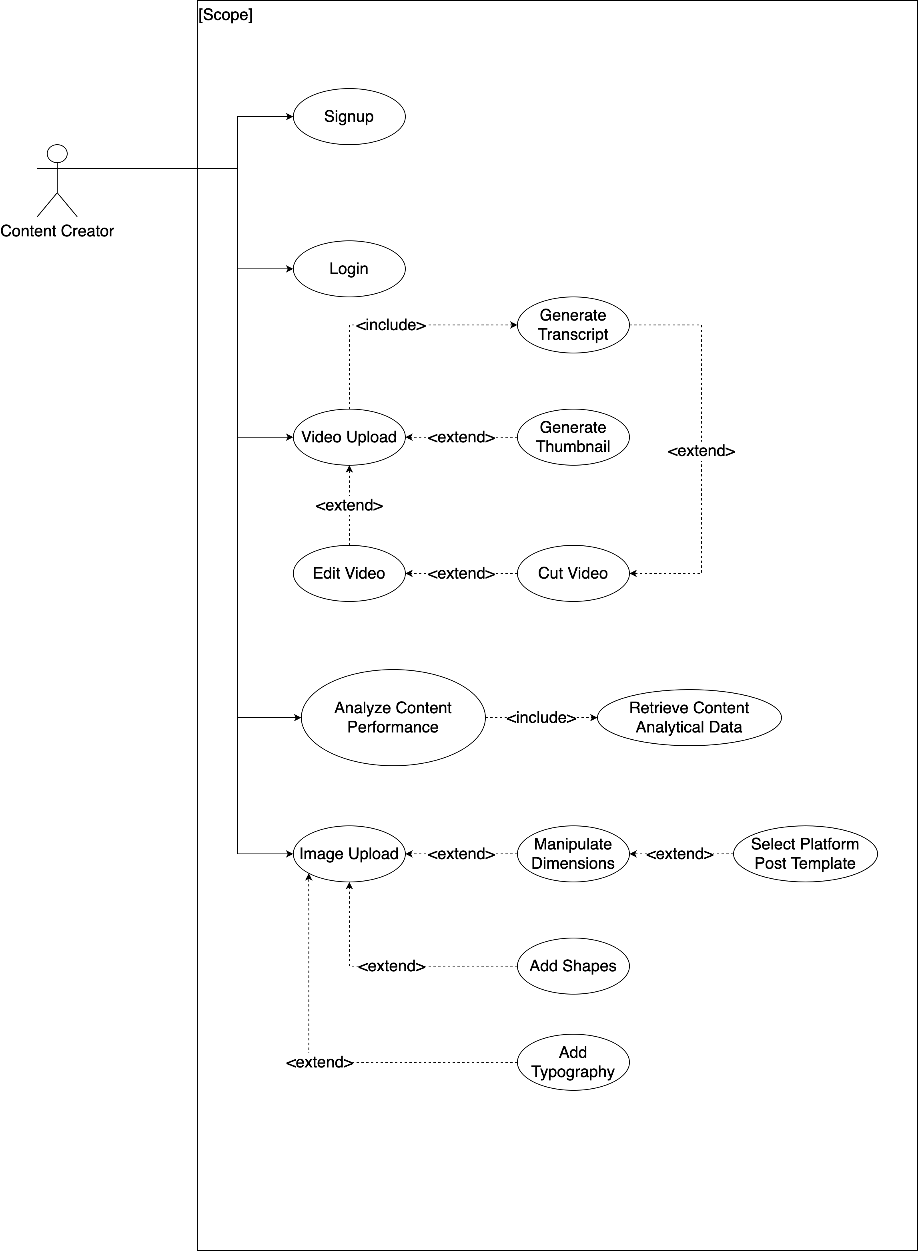
Use Case

Slide 9
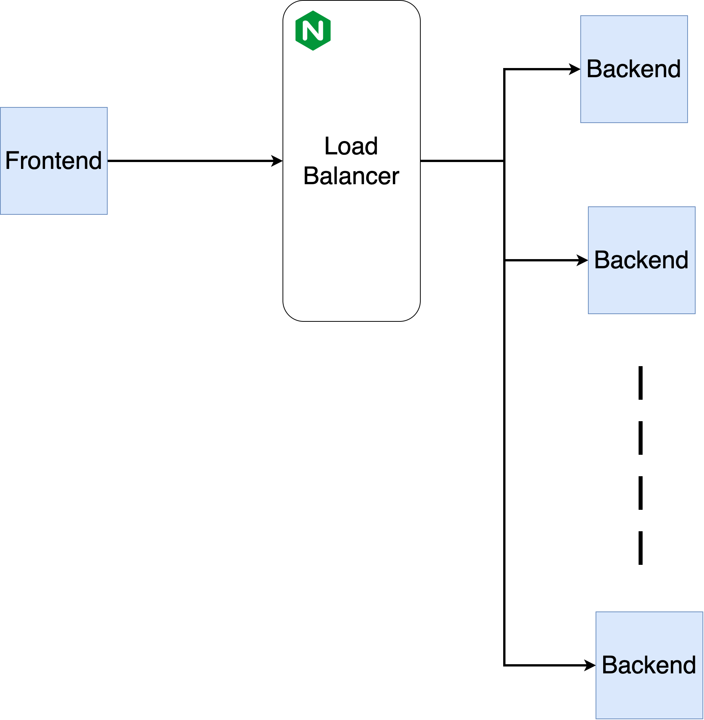
High-Level Block

Slide 10
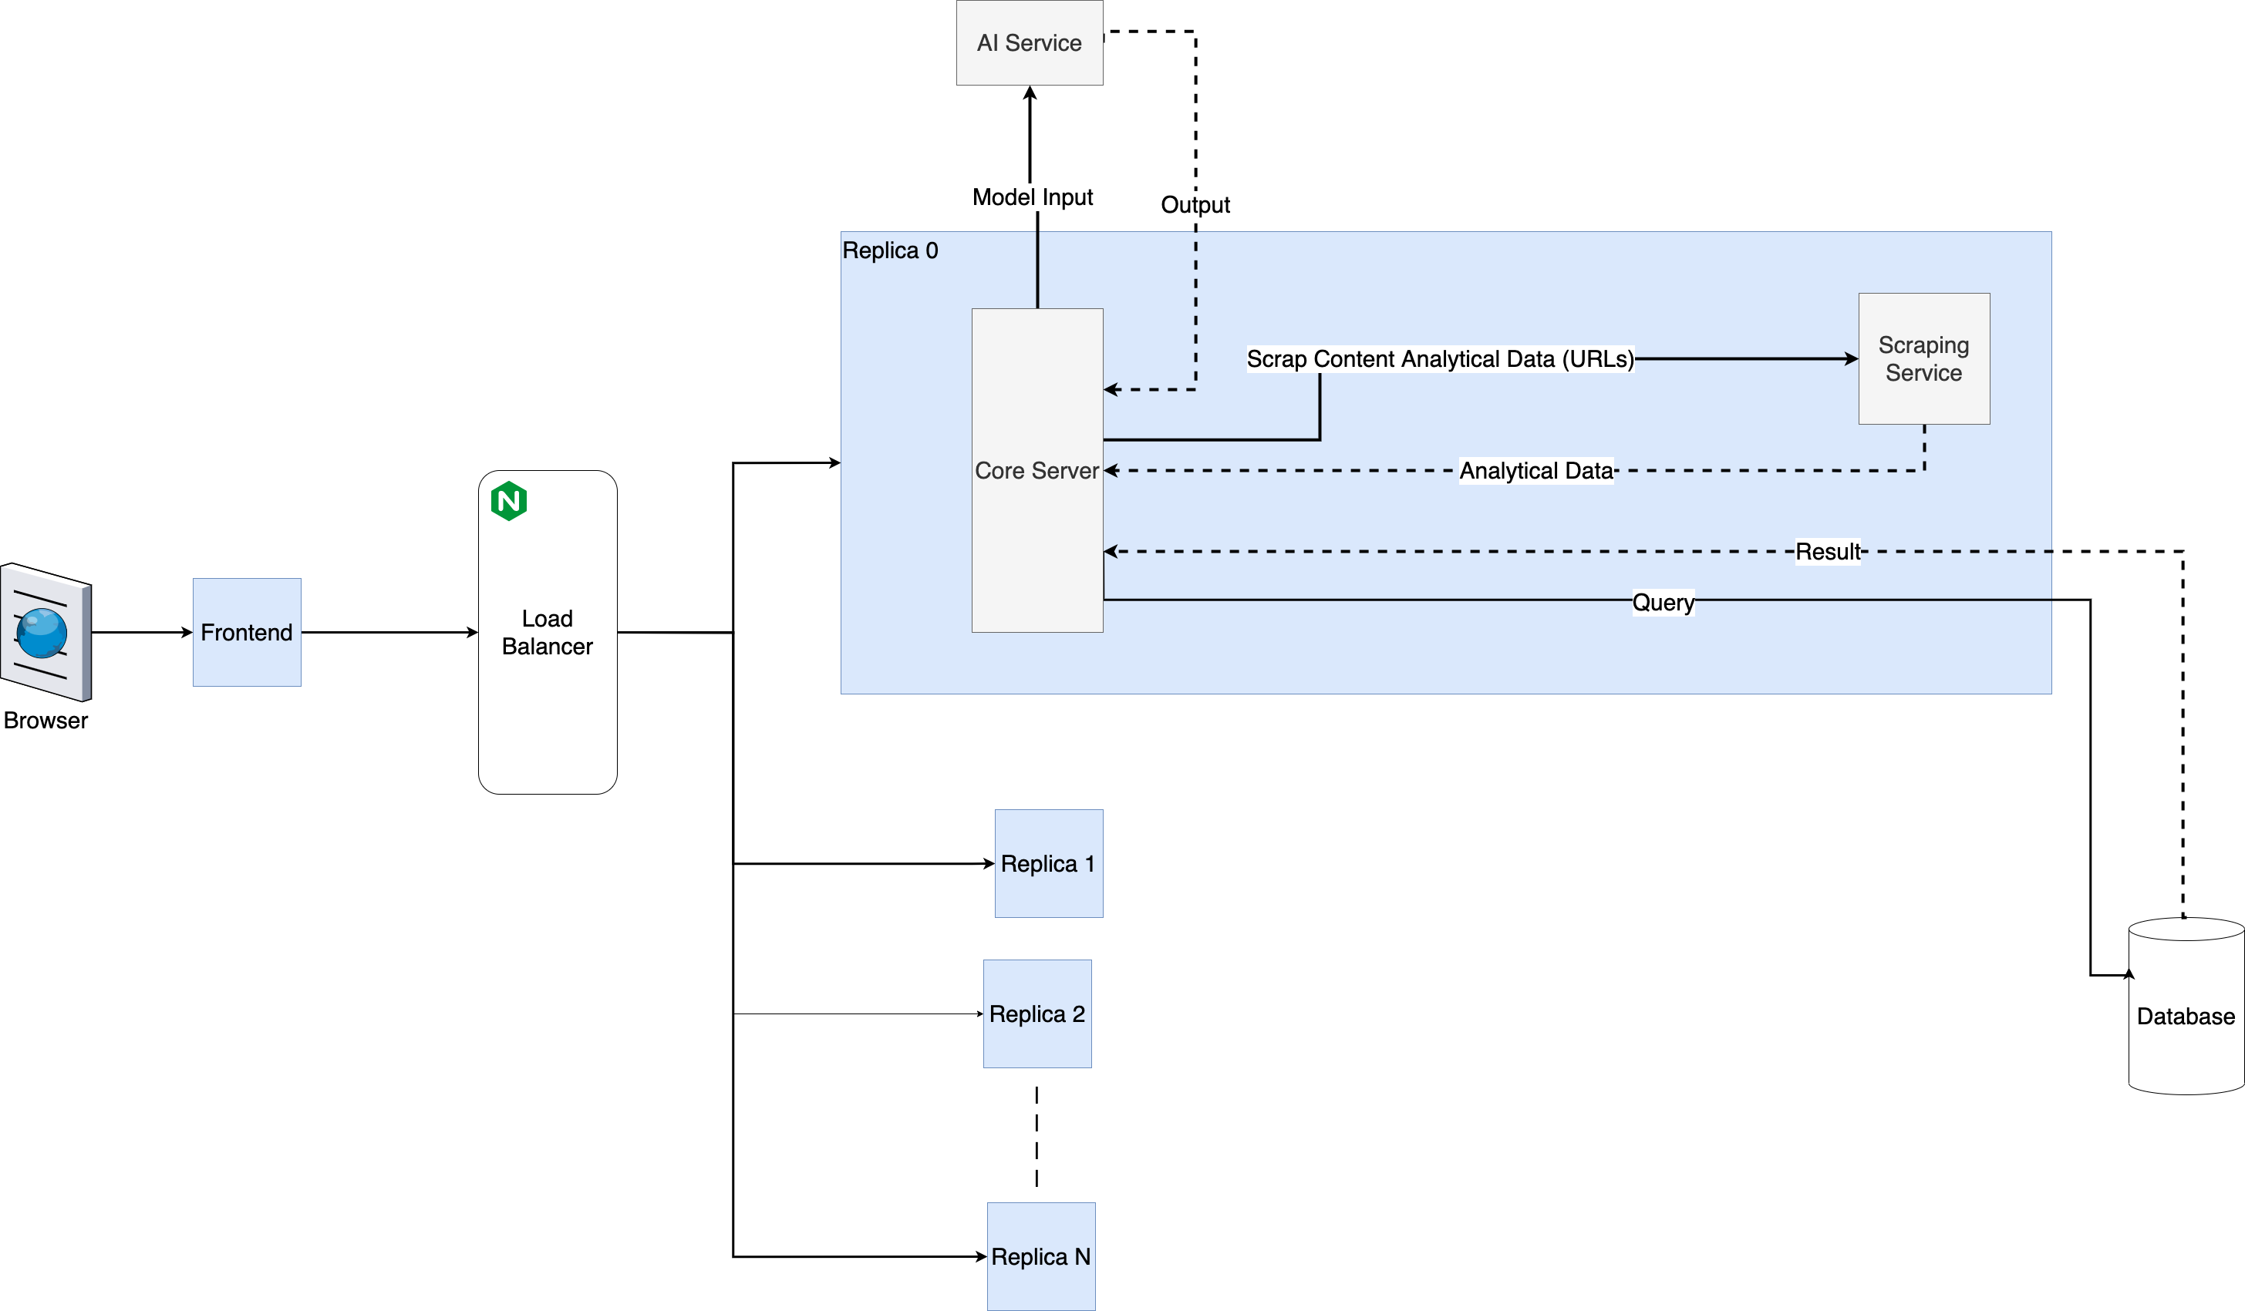
Low-Level Block

Slide 11
Functional Requirements
Edit Video
Create Artwork
Track Audiences Engagement
Analyse Content Performance
Non-Functional Requirements
Scalable
Reliable
Easy to Use
Portable

Slide 12
Outlines
Scope
Analysis Phase
AI Section
Technologies
Now & Next

Slide 13
AI Section
Automatic Speech Recognition
Data Sets
Models
Fine Tuning

Slide 14
Automatic Speech Recognition

Slide 15
AI Section
Automatic Speech Recognition
Data Sets
Models
Fine Tuning

Slide 16
Data Sets
Common voice
The LJ Speech Dataset
AudioSet

Slide 17
Data Sets
 | Validated | Common speech | Human speech only | Transcript available
Common Voice | yes | yes | yes | yes
The LJ Speech Dataset | yes | no | yes | yes
AudioSet | no | yes | no | no

Slide 18
Models
Whisper
Wav2vec
SpeechT5 (ASR task)
HuBERT

Slide 19
AI Section
Automatic Speech Recognition
Data Sets
Models
Fine Tuning

Slide 20
 | Whisper | SpeechT5 (ASR task) | Wav2vec | HuBERT
Architecture | Transformer based encoder-decoder Deep Clustering + fine-tuning | Transformer pre-nets and post-nets | based on the Transformer's encoder | Masked LM (MLM)
Training Data | 680,000 hours of labelled audio-transcription data | unlabelled speech and text data | Unlabelled data | Unlabelled data
Strengths | Robust to noise and accents | Contextual understanding | Effective feature extraction | Captures long-term dependencies
Weaknesses | Not suitable for all ASR tasks | Dependency on labeled data | Sensitive to noise | May lack context understanding

Slide 21
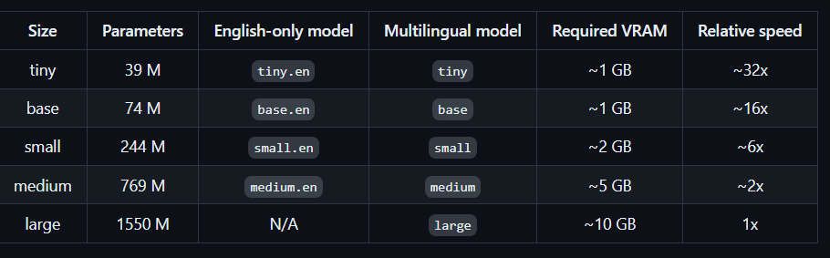
Whisper Versions and Fine tuning

Slide 22
AI Section
Automatic Speech Recognition
Data Sets
Models
Fine Tuning

Slide 23
Fine Tuning

Slide 24
Outlines
Scope
Analysis Phase
AI Section
Technologies
Now & Next

Slide 25








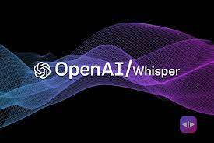



Technologies

Slide 26
Outlines
Scope
Analysis Phase
AI Section
Technologies
Now & Next

Slide 27
Now & Next
 | Week 1 |  | Week 2 |  | Week 3 | Week 4 | Week 5 | Week 6 | Week 7
Requirement
Analysis
Design
Implementation
65%
55%
50%
40%

